Slide 1
Module 2 – Introduction & Overview to Power Automate

Slide 2

Objective
In this module you will get an introduction to Power Automate and an overview of the components

Slide 3

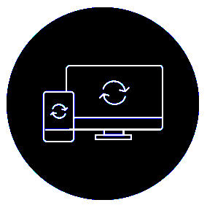
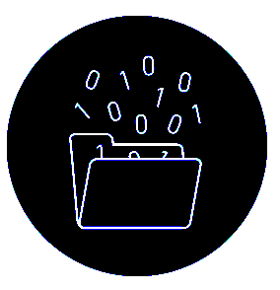

Microsoft Power Automate
Helps business-power-users work smarter by automating workflows across apps and services. Workflows in Power Automate are called “Flows”
Get notifications
Copy files
Collect data
Automate approvals

Slide 4
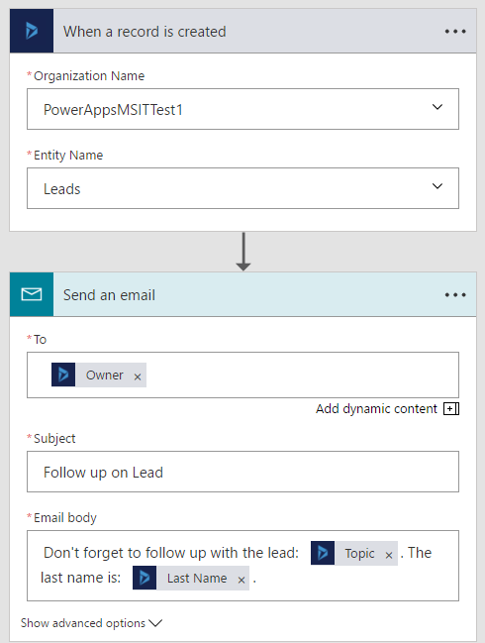
What makes up a Flow?
Trigger:
The event that kicks off the flow:
Manually
On a schedule
On an event in the cloud.
Actions:
What the flow does:
Uses data from the trigger.

Slide 5
Flow process
Trigger
One trigger to start flow:
A trigger is a condition or check that will kick off a flow.
Scheduled.
PowerApps button click or control select event.
File/E-mail/Contact created.
HTTP Triggered/Webhook.
Actions (1…n)
Any number of actions after trigger:
If the trigger condition is successfully met any number of subsequent actions can take place:
For example “…look up the current user’s profile and then email that user’s manager”.

Slide 6
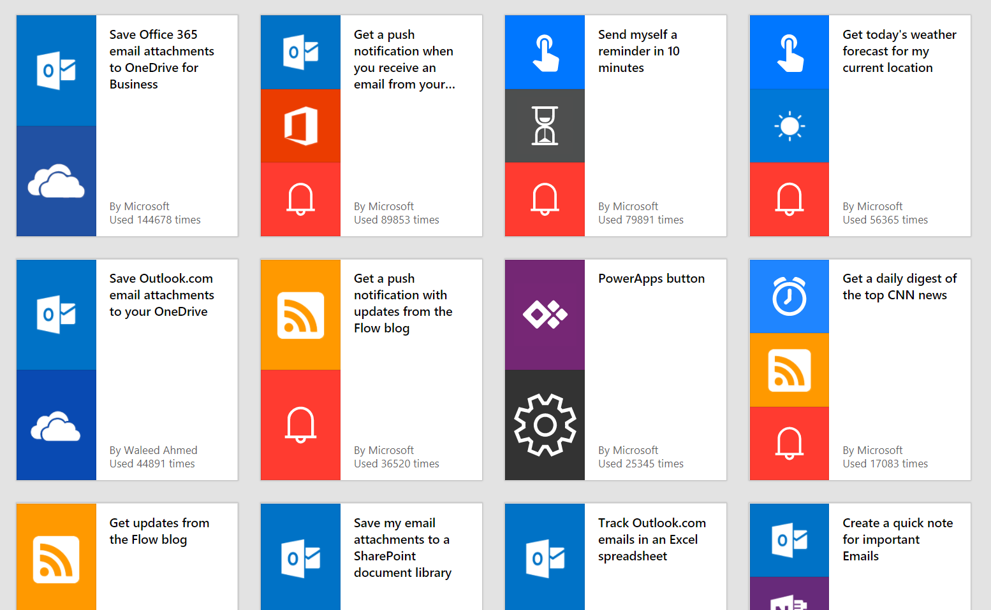
Get started quickly with a growing library of templates - 700+

Slide 7
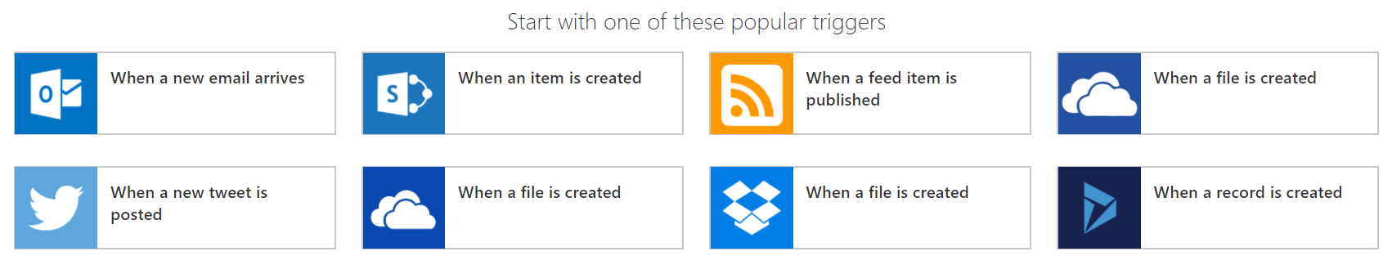
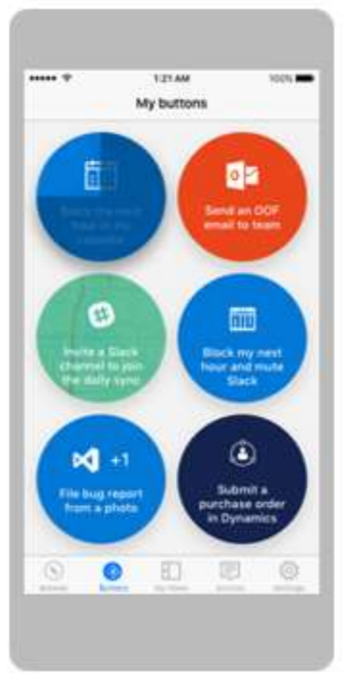
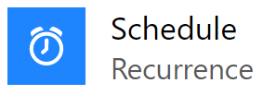
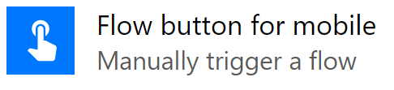
Start from a blank
Can also be a Schedule or a Button

Slide 8
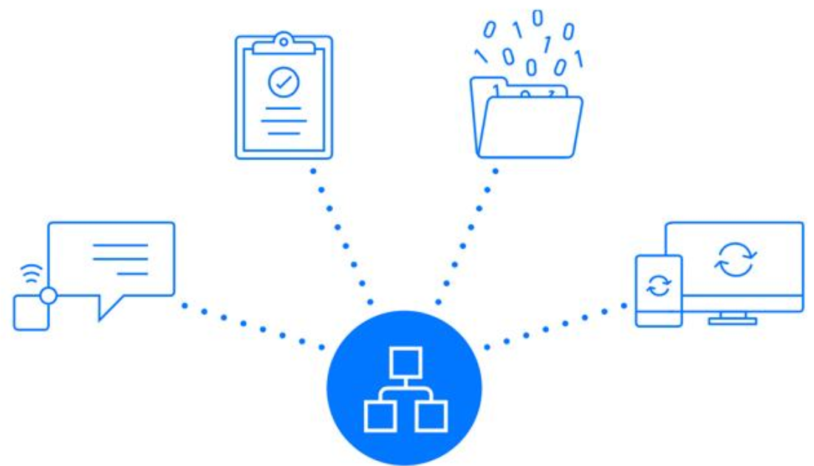
Connectors
Connecters can be used to connect
in and out from the flow.

Slide 9
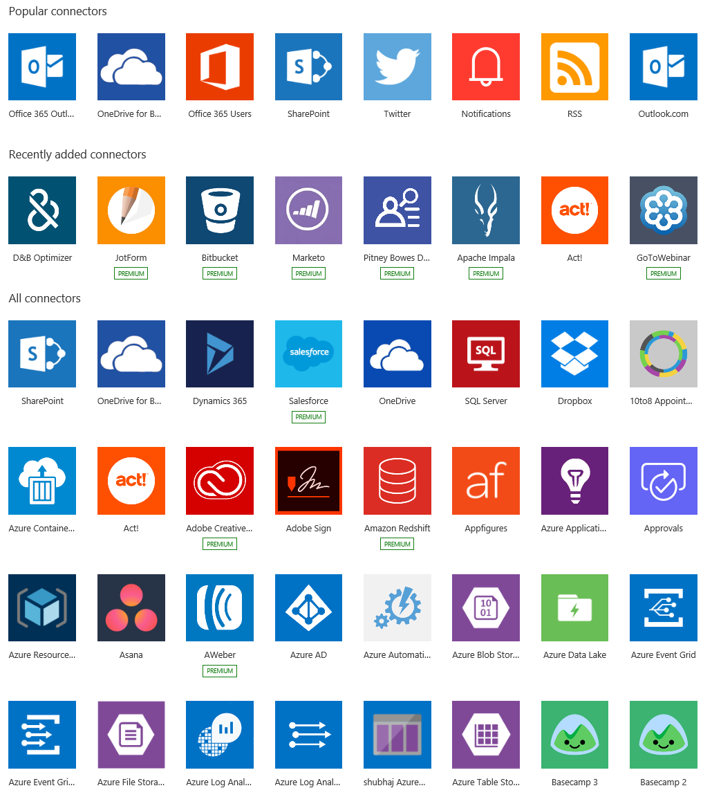
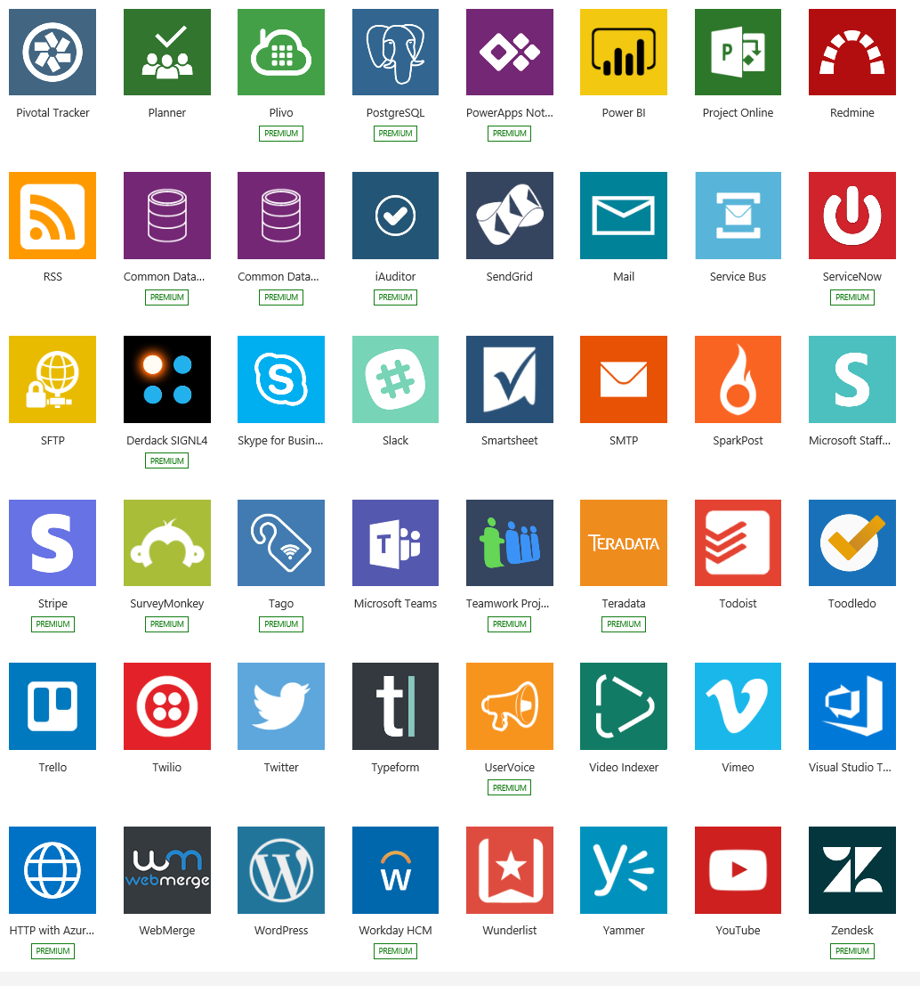
Flow Connectors Gallery 450+

Slide 10
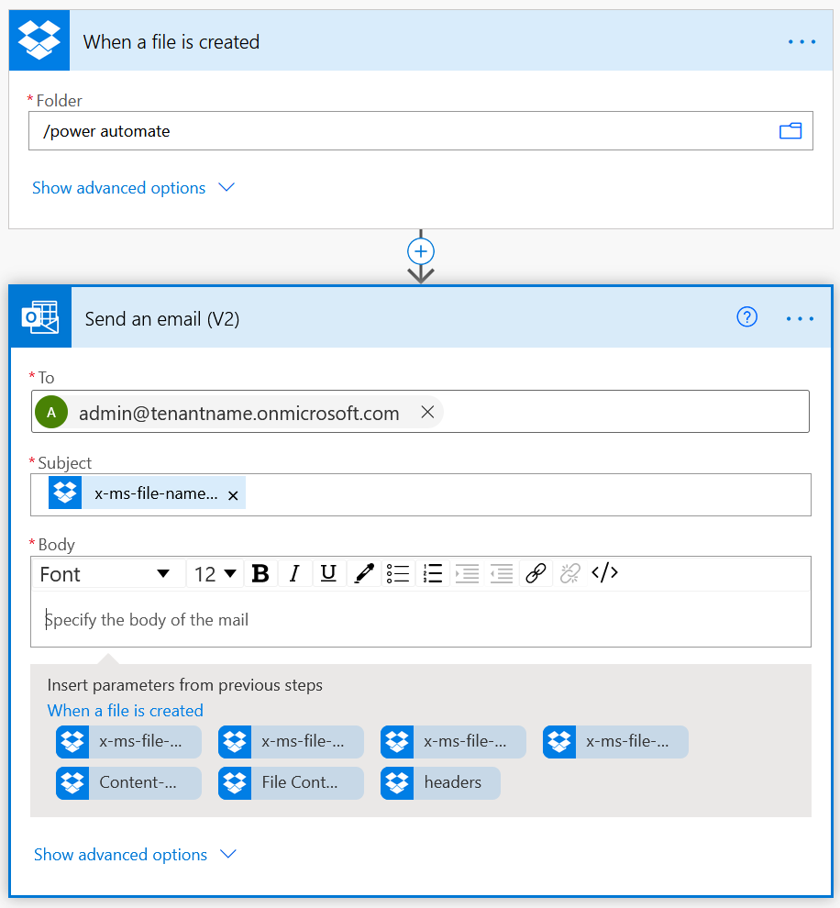
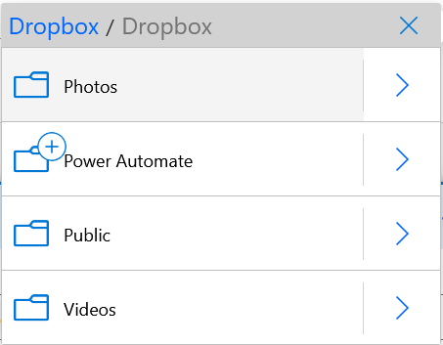
Build your own flows in an easy-to-use Visual Designer
Sending an Exchange email when a new file is added in Dropbox
Authenticate to your Dropbox account.
Select folder to monitor
Choose to include properties from previous step (Dropbox file) to improve relevance
Authenticate to your O365 account. Build email Subject and Body
Specify Send To email address and additional properties (optional): From, CC, BCC and Importance

Slide 11
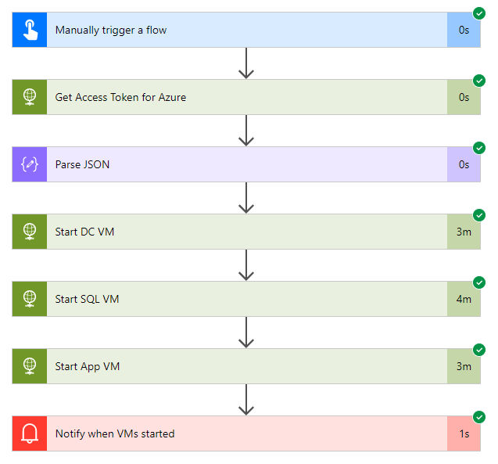
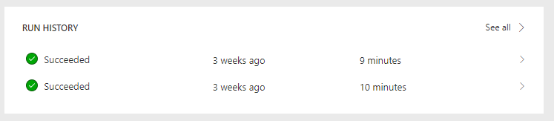
Track history of flow runs
Run history stored for 28 days
See flow run success or failure with ability
to dive into more details as needed
Notes:
Documentation:
https://docs.microsoft.com/en-us/flow/modern-approvals

